Slide 1
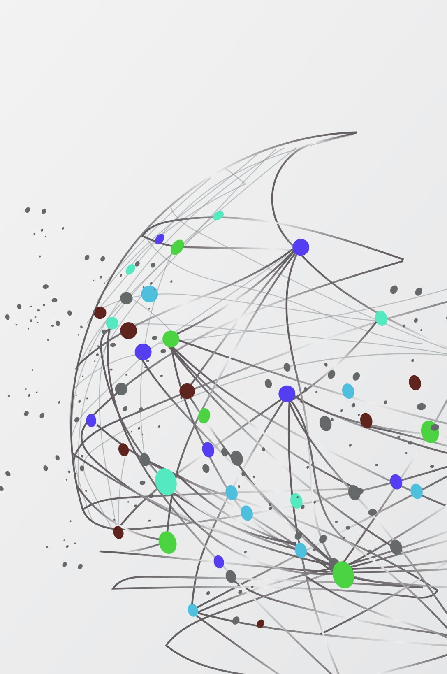

Long Term Unemployment from around The Great Recession
By Kristin Scully

Slide 2
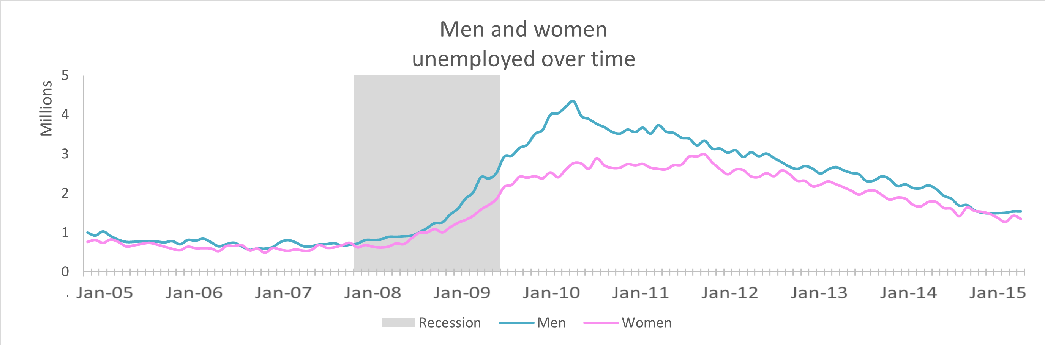
Men vs Women
Unemployment of men and women remained about the same from 2005 till about the end of 2008.
There was a rise in unemployed men during the great recession (2007-2009)
By mid-2008 both men and women were seeing a rise in long term unemployment.
At this point men were experiencing long term unemployment greater than their female counterparts, peaking in early 2010.

Slide 3
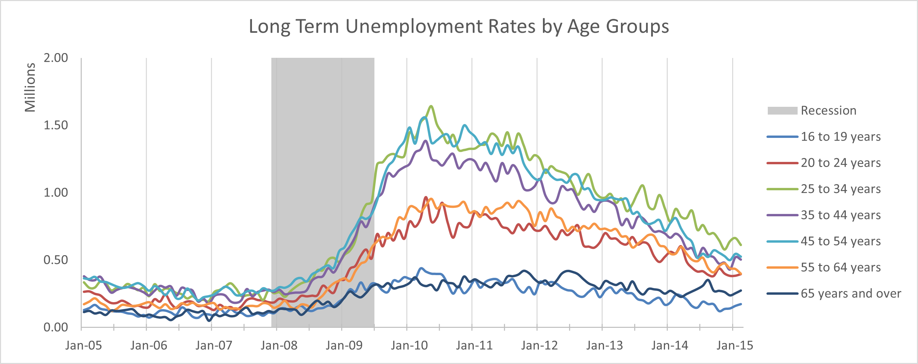
Age Groups over time
Teenagers and people of retirement age and older are the least unemployed without much change after the great recession.
People between the ages of 25 and 54 were the most unemployed of all age groups.
They saw a large uptick in unemployment from the recession peaking in early 2010.

Slide 4
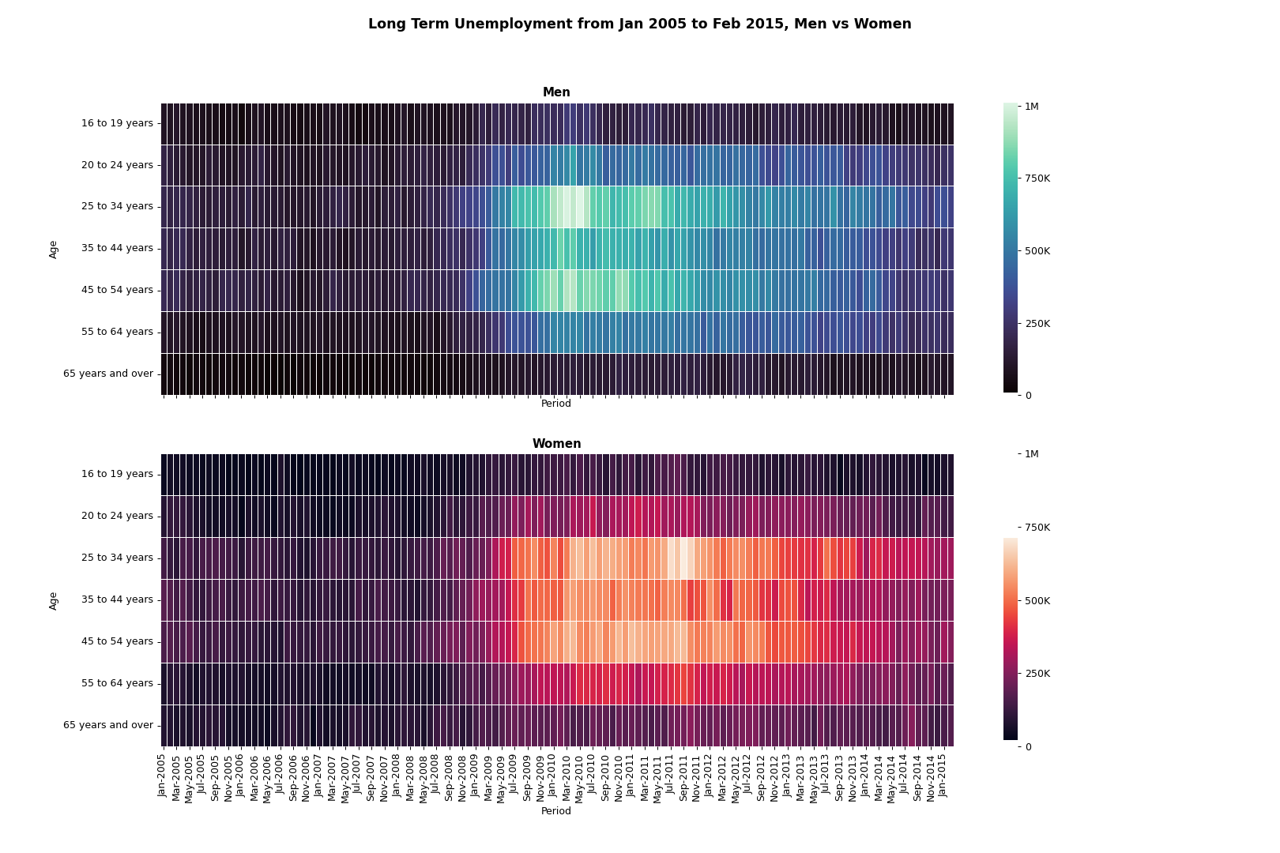
Men, Women, and Age Groups Over Time
Men had a higher number of unemployment overall, with maximums reaching one-million, while women capped out around 750K.
In both genders the most unemployment was seen in ages 25-54 from September 2008 to mid 2013, while those aged 25-34 had the slowest recovery.

Slide 5
Conclusion
The great recession was a challenging time for everyone in the workforce.
What we don’t know is how many people were in the workforce to begin with.
Did women have smaller unemployment overall because there were less women in the workforce?
Are there social reasons for men having larger unemployment numbers?
Teenagers and people of retirement age and older are the least unemployed without much change after the great recession. They have the least number of people in the work force.
People between the ages of 25 and 54 were the most unemployed of all age groups.

Slide 6
References
Weinberg, J. (2013, November 22). The great recession and its aftermath. Federal Reserve History. https://www.federalreservehistory.org/essays/great-recession-and-its-aftermath

